Slide 1

图数据库组会汇报
报告人
徐柴俊
xuchaijun@mail.ustc.edu.cn
中国科学技术大学 计算机科学与技术学院
2024年09月25日

Slide 2
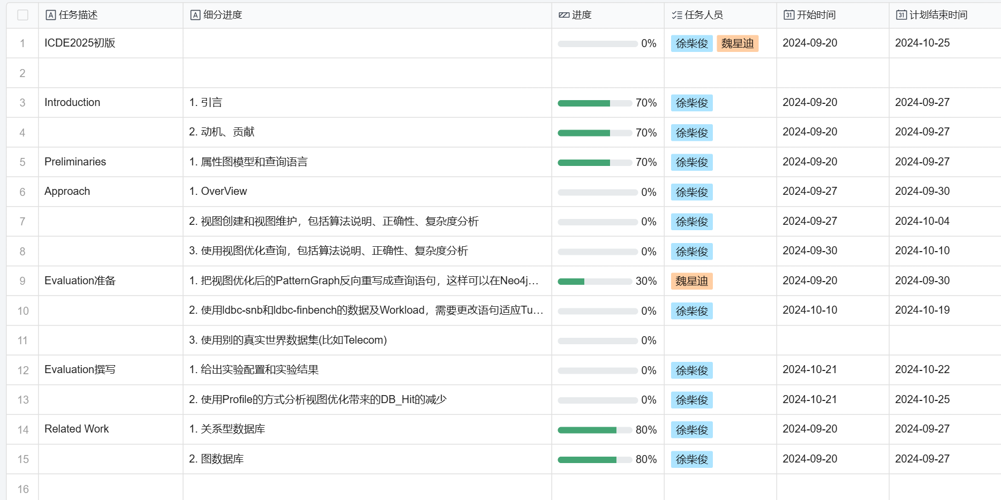
任务进度

Slide 3
徐柴俊工作进度
Introduction: 动机、方法介绍、例子、贡献
Preliminaries：属性图模型、查询语言、Pattern Graph
Related Work：关系型数据库、图数据库

Slide 4
徐柴俊工作进度
Introduction例子
视图创建
视图维护
n
:Comment
r:replyOf*..
m
:Post
n
:Comment
r:ROOT_POST
m
:Post
n
:Comment{id:1}
r:replyOf*..
m
:Post
n
:Comment
r1:replyOf*..
:Comment{id:1}
r2:replyOf*0..
m
:Post

Slide 5
徐柴俊工作进度
Introduction例子
使用视图优化查询
c
:Comment
r1:replyOf*..
p
:Post
r2:containerOf
f
:Forum
c
:Comment
@M_r1:ROOT_POST
p
:Post
r2:containerOf
f
:Forum

Slide 6
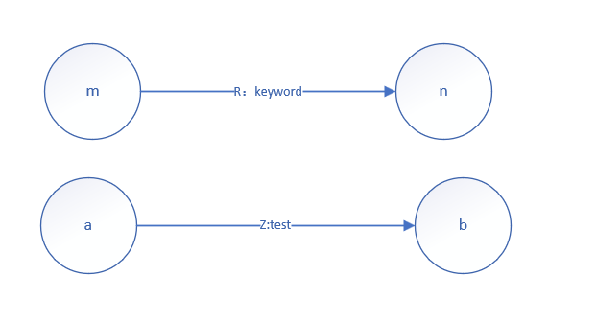
魏星迪工作进度
为了在 Neo4j 里测试优化效果，要把使用视图优化后的 PatternGraph反向重写为 Cypher 语句。比如match(n : Comment) − [r : replyOf ∗ 1..]− > (m : Post)returnn, m这里有两个 replyOf ∗ 1.. 可以用 ROOT _P OST 优化，可以重写为match(n : Comment) − [r : ROOT _POST ]− > (m : Post)returnn, m输出为优化后的查询语句，测试时在需要优化的Cypher 语句前加上 Optimize 即可，比如在 tugraph 中输入 Cypher 语句：Optimizematch(n : Comment)−[r : replyOf ∗1..]− > (m : P ost)returnn, m应该返回 match(n : Comment)−[r : ROOTP OST ]− > (m : Post)returnn, m
Match（m）-[r:keyword]->(n),
(a)-[z:test]->(b)
Patterngraph
Anti cypher

Slide 7
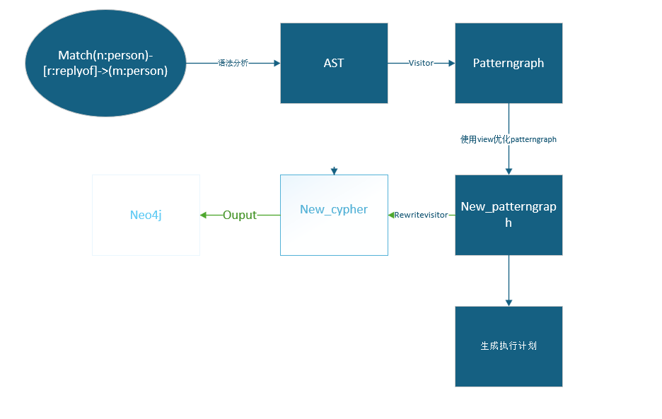
魏星迪工作进度
Tugraph cypher处理过程

Slide 8
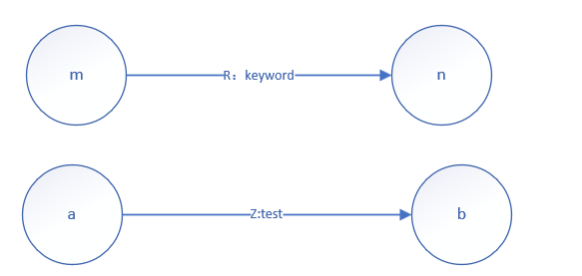
魏星迪工作进度
函数的输入为cypher::RTContext ∗ctx, antlr4 :: tree :: ParseTree ∗tree, const std ::vector <cypher :: PatternGraph> &pattern_graphs,这里的 &patterng raphs 是优化后的 PatternGraphs函数的输入
例如这个patterngraph
其中含有的nodes:m,n,a,b
其中含有的relationships：
r:keyword
z:test
此时通过遍历patterngraph应该得到的cypher语句应该是
Match（m）-[r:keyword]->(n),(a)-[z:test]->(b)
其中r:keyword和z:test可能是通过视图优化后的边。

Slide 9
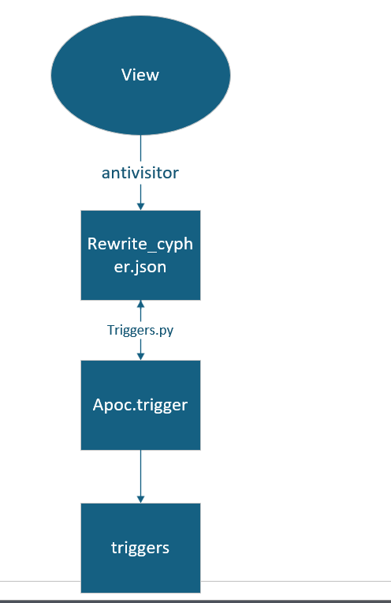
魏星迪工作进度
Neo4j视图维护
借用neo4j扩展apoc触发器来维护视图
match (n:Comment)-[:replyOf*..]->(m:Post) WITH n,m CREATE (n)-[r:ROOT_POST]->(m)

Slide 10
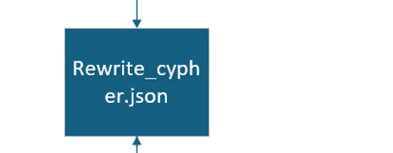
魏星迪工作进度
rewrite_cypher.json
Neo4j视图维护
借用neo4j扩展apoc触发器来维护视图
{
"match (n:Comment)-[:replyOf*..]->(m:Post) WITH n,m CREATE (n)-[r:ROOT_POST]->(m)": [
[
"match (n:Comment)-[*0]-(viewvetex)-[:replyOf*..]->(m:Post) WITH n,m match (n)-[r:ROOT_POST]->(m) WITH n,m,collect(r) as view delete view[0]",
"match (n:Comment)-[:replyOf*..]->(m:Post)-[*0]-(viewvetex) WITH n,m match (n)-[r:ROOT_POST]->(m) WITH n,m,collect(r) as view delete view[0]",
"match (n:Comment)-[:replyOf*1..]->(viewvetex)->[:replyOf*0..]->(m:Post) WITH n,m match (n)-[r:ROOT_POST]->(m) WITH n,m,collect(r) as view delete view[0]"
],
[
"match (n:Comment)-[:replyOf*0..]->()-[viewedge:replyOf]->()-[:replyOf*0..]->(m:Post) WITH n,m CREATE (n)-[r:ROOT_POST]->(m)"
],
[
"match (n:Comment)-[:replyOf*0..]->()-[viewedge:replyOf]->()-[:replyOf*0..]->(m:Post) WITH n,m match (n)-[r:ROOT_POST]->(m) WITH n,m,collect(r) as view delete view[0]"
]
]
}

Slide 11

魏星迪工作进度
CALL apoc.trigger.add(
'triggerOnEdgeDelete',
'
UNWIND $deletedRelationships AS viewedge
// 只匹配 isview 属性为空的边
WITH viewedge
WHERE viewedge.isview IS NULL
MATCH (n:Comment)-[:replyOf*0..]->()-[viewedge:replyOf]->()-[:replyOf*0..]->(m:Post)
WITH n,m
MATCH (n)-[r:ROOT_POST]->(m)
WITH n,m,collect(r) AS view
DELETE view[0]
',
{phase: "before"}
)
Neo4j视图维护
借用neo4j扩展apoc触发器来维护视图

Slide 12
魏星迪工作进度
目前进度
修改了tugraph中的视图维护语句逻辑，从特定点和边的语句改成了模板类型，访问器只需要接受视图语句便可以输出针对该视图的重写语句
neo4j的视图维护部分增添边部分可以成功维护借助apoc.trigger，并且可以通过python脚本完成多个视图触发语句的部署
问题在删除部分,本来添加了一条属性{isview}防止其递归调用触发器，在手动测试维护逻辑，可以正常维护
，但apoc.trigger在删除时，phase选用before，neo4j也会认为边已被删除，导致后续维护逻辑无法进行。
CALL apoc.trigger.install( 'myTrigger', 'UNWIND $deletedRelationships AS r WITH r WHERE NOT r.is_view = true
// 视图维护语句
.....

Slide 13
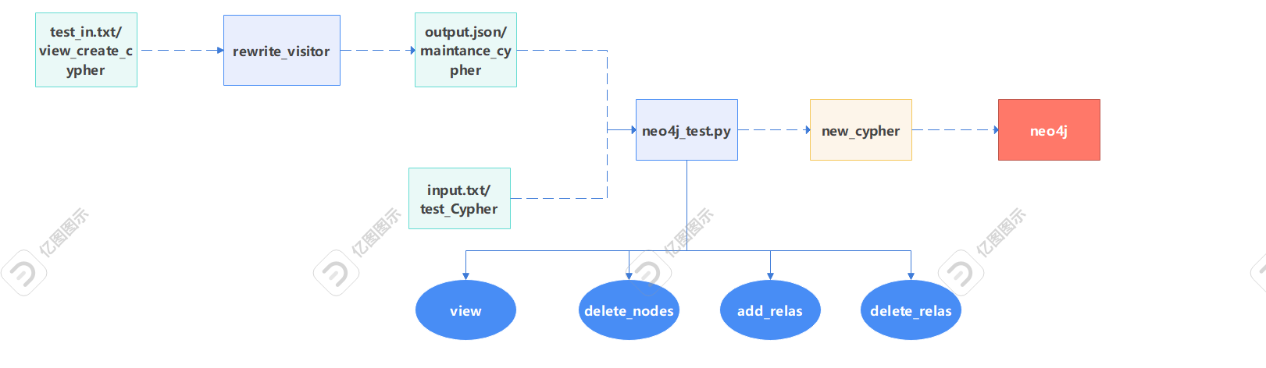
魏星迪工作进度
neo4j测试方法框图

Slide 14
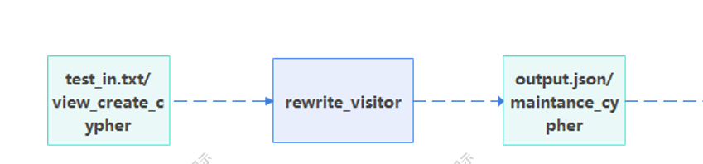
魏星迪工作进度
rewrite_visitor模块：
根据保存在test_in.txt中的视图创建语句，
生成其对应的视图维护语句，其中包括删除 点，增加边，删除边的维护语句。
输入：视图创建语句
输出output.json，视图维护语句

Slide 15
魏星迪工作进度
rewrite_visitor 生成规则：
对于点的删除，要将可变长的边进行展开再讨论 node 的位置，对于一条可变长边 [∗x..y] 可将其展开为：
∗Match(n)−[∗0]−>(k)−[∗x..y]−>(m)
∗Match(n)−[∗1]−>(k)−[∗{x − 1..{y −1]−>(m)
...
∗Match(n)−[x]−> (k)−[∗0..{y − x} ]−>(m)
∗Match(n)−[∗{x + 1}]−>(k)−[∗0..{y − x −1]−>(m)
...
∗Match(n)−[∗y]−>(k)−[∗0]−>(m)
----------------------------------------------------
∗Match(n)−[∗0]−>(k)−[∗{x−1}..]− > (m)
∗Match(n)−[∗1]−>(k)−[∗{x−2}..]− > (m)
...
∗Match(n)−[∗x..]− > (k) − [∗0..]− > (m)
对于无上界的可变长边 [∗x..] 可将其展开为：
∗Match(n) − [*0]− > (src) − [r]− > (dst) − [*{x − 1}..]− > (m)
∗Match(n) − [*1]− > (src) − [r]− > (dst) − [*{x − 2}..]− > (m)
...
∗Match(n)−[*i]−>(src) − [r]− > (dst) − [*{x − 1 − i}..]− > (m)
...
∗Match(n)−[*{x − 1}..]− > (src) − [r]− > (dst) − [*0..]− > (m)
对于有上界的可变长边 [*x..y] 可将其展开为：
∗Match(n)−[*0]−>(src)−[r]−>(dst)−[*{x − 1}..{y − 1}]− > (m)
∗Match(n)−[*1]−>(src)−[r]−>(dst)−[*{x − 2}..{y − 2}]− > (m)
...
∗Match(n)−[*i]−>(src)−[r]−>(dst)−[*{x−1− i}..{y−1−i}]−> (m)
...
∗Match(n)−[*{x − 1}]−>(src)−[r]−> (dst) − [*0..{y − x}]− > (m)
∗Match(n) − [*x]− > (src) − [r]−>(dst)−[*0..{y − x − 1}]− > (m)
...
∗Match(n)−[*{y − 1}]−>(src) − [r]− > (dst) − [*0]− > (m)

Slide 16
魏星迪工作进度
rewrite_visitor模块：
例：test_in.txt->”match (n:Comment)-[:replyOf*..]->(m:Post) WITH n,m CREATE (n)-[r:ROOT_POST]->(m)”
output.json:
{
"match (n:Comment)-[:replyOf*..]->(m:Post) WITH n,m CREATE (n)-[r:ROOT_POST]->(m)": [
[
"optional match (n:Comment)-[*0]-(viewvetex)-[:replyOf*..]->(m:Post) WITH n,m,viewvetex optional match (n)-[r:ROOT_POST]->(m) WITH n,m,viewvetex,collect(r) as view delete view[0]",
"optional match (n:Comment)-[:replyOf*..]->(m:Post)-[*0]-(viewvetex) WITH n,m,viewvetex optional match (n)-[r:ROOT_POST]->(m) WITH n,m,viewvetex,collect(r) as view delete view[0]",
"optional match (n:Comment)-[:replyOf*1..]->(viewvetex)->[:replyOf*0..]->(m:Post) WITH n,m,viewvetex optional match (n)-[r:ROOT_POST]->(m) WITH n,m,viewvetex,collect(r) as view delete view[0]"
],
[
"optional match (n:Comment)-[:replyOf*0..]->()-[viewedge:replyOf]->()-[:replyOf*0..]->(m:Post) WITH n,m,viewedge CREATE (n)-[r:ROOT_POST]->(m)"
],
[
"optional match (n:Comment)-[:replyOf*0..]->()-[viewedge:replyOf]->()-[:replyOf*0..]->(m:Post) WITH n,m,viewedge optional match (n)-[r:ROOT_POST]->(m) WITH n,m,viewedge,collect(r) as view delete view[0]"
]
]
}

Slide 17
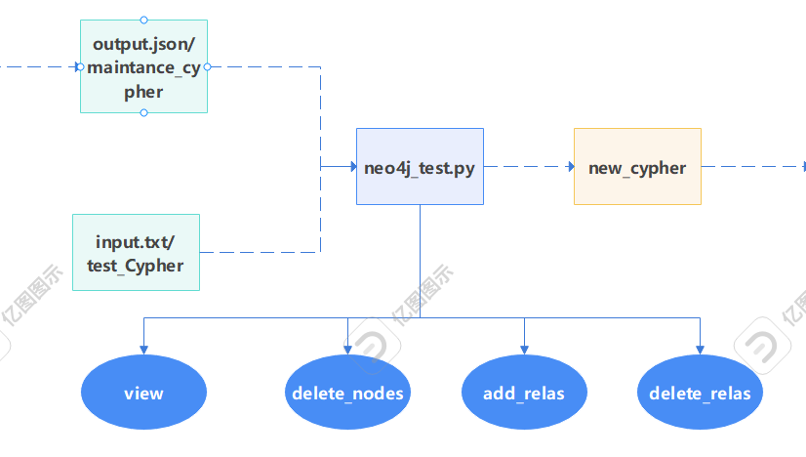
魏星迪工作进度
neo4j_test模块：
根据保存在output.json中的rewrite_visitor的输出也就是 视图维护语句以及需要运行的cypher语句（可以选择将 其保存在input.txt中）产生新的附带有视图维护语句的实 际执行语句。
输入：视图维护语句，需要运行的cypher语句
输出new_cypher->带有视图维护语句的cypher语句

Slide 18
魏星迪工作进度
neo4j_test模块：
new_cypher生成规则：
在neo4j_test中定义了如图中的四个列表，分别为view(保 存视图创建语句），delete_nodes(保存视图删除点的维护 语句），add_relas（添加边的维护语句），delete_relas （删除边的维护语句）。其结果由其中的输入（output. json）得到。
根据input.txt中取得的cypher语句中的不同关键字如，delete，create来判别此条cypher语句的目的，并且由此得到不同的添加了视图维护语句的new_cypher。
test_cypher+$connection_cypher+$UNWIND+∑with viewedge+add_relas[i] if add_relas
new_cypher= $connection_cypher+$UNWIND+∑with viewedge+dele_relas[i]+test_cypher if dele_relas
$connection_cypher+$UNWIND+∑with viewvetex+dele_node[i]+test_cypher if dele_nodes
connection_cypher=with [vars] as deviews
UNWIND=UNWIND deviews as viewedge/viewvetex

Slide 19
test_cypher | new_cypher
match(n:Comment{CommentId:"2061584302086"})-[r:replyOf]->(m:Post{id:"2061584302084"}) with r limit 1 delete r | match(n:Comment{CommentId:"2061584302086"})-[r:replyOf]->(m:Post{id:"2061584302084"}) with r limit 1 WITH [r] as deleviews UNWIND deleviews as viewedge optional match (n:Comment)-[:replyOf*0..]->()-[viewedge:replyOf]->()-[:replyOf*0..]->(m:Post) WITH n,m,viewedge optional match (n)-[r:ROOT_POST]->(m) WITH n,m,viewedge,collect(r) as view delete view[0] with viewedge match(n:Comment{CommentId:"2061584302086"})-[r:replyOf]->(m:Post{id:"2061584302084"}) with r limit 1 delete r
match(n:Comment{CommentId:\"2061584302086\"}),(m:Post{id:\"2061584302084\"}) with n,m create (n)-[:replyOf{creationDate:1266604713724}]->(m) | match(n:Comment{CommentId:\"2061584302086\"}),(m:Post{id:\"2061584302084\"}) with n,m create (n)-[r:replyOf{creationDate:1266604713724}]->(m) WITH [r] as createviews UNWIND createviews as viewedge optional match (n:Comment)-[:replyOf*0..]->()-[viewedge:replyOf]->()-[:replyOf*0..]->(m:Post) WITH n,m,viewedge CREATE (n)-[r:ROOT_POST]->(m)
match(n:Comment{CommentId:\"2061584302086\"})-[r:replyOf]->(m:Post{id:\"2061584302084\"}) return n,r,m | match(n:Comment{CommentId:\"2061584302086\"})-[r:replyOf]->(m:Post{id:\"2061584302084\"}) return n,r,m
new_cypher生成实例
add_relas | delete_relas | delete_nodes
optional match (n:Comment)-[:replyOf*0..]->()-[viewedge:replyOf]->()-[:replyOf*0..]->(m:Post) WITH n,m,viewedge CREATE (n)-[r:ROOT_POST]->(m) | optional match (n:Comment)-[:replyOf*0..]->()-[viewedge:replyOf]->()-[:replyOf*0..]->(m:Post) WITH n,m,viewedge optional match (n)-[r:ROOT_POST]->(m) WITH n,m,viewedge,collect(r) as view delete view[0] | "optional match (n:Comment)-[*0]-(viewvetex)-[:replyOf*..]->(m:Post) WITH n,m,viewvetex optional match (n)-[r:ROOT_POST]->(m) WITH n,m,viewvetex,collect(r) as view delete view[0]",
 |  | "optional match (n:Comment)-[:replyOf*..]->(m:Post)-[*0]-(viewvetex) WITH n,m,viewvetex optional match (n)-[r:ROOT_POST]->(m) WITH n,m,viewvetex,collect(r) as view delete view[0]",
 |  | "optional match (n:Comment)-[:replyOf*1..]->(viewvetex)->[:replyOf*0..]->(m:Post) WITH n,m,viewvetex optional match (n)-[r:ROOT_POST]->(m) WITH n,m,viewvetex,collect(r) as view delete view[0]"

Slide 20
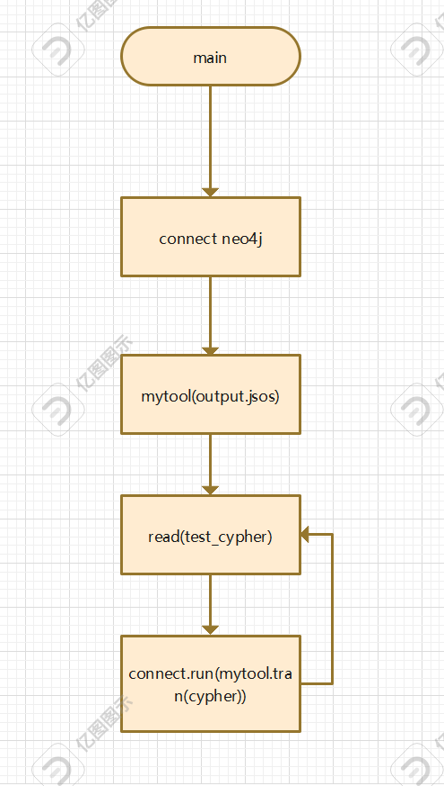
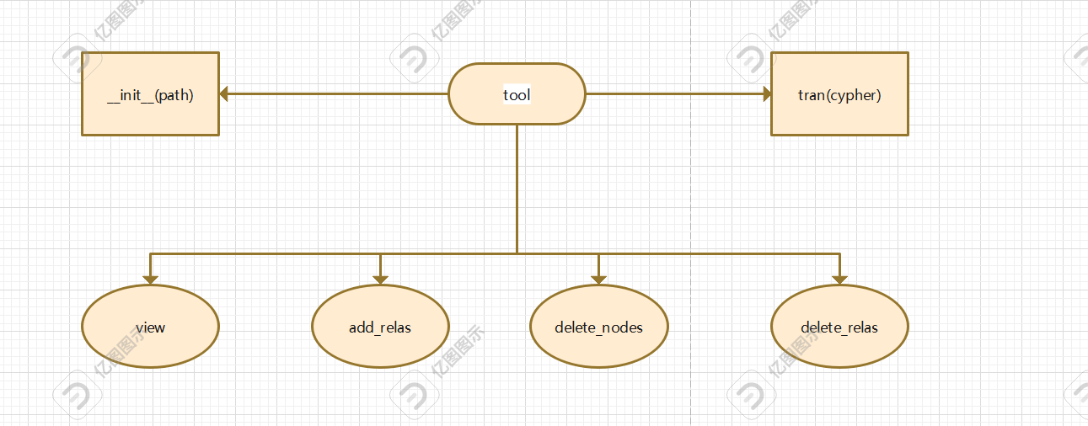
魏星迪工作进度
neo4j_test.py执行流程

Slide 21
魏星迪工作进度
VIEW:
MATCH (n:Account)-[r1*..2]->(m:Loan) where all(rel in r1 where rel.is_view is null) with n,m CREATE (n)-[r:ACCOUNT_LOAN{is_view:true}]->(m)
特殊情况
r1
m:Account
n1
n:Loan
r2
view_edge
n3
optional match (n:Account)-[ANONR2*1]->()-[view_edge]->()-[ANONR3*0]->(m:Loan) WHERE ALL(rel IN ANONR2 WHERE rel.is_view is null) AND view_edge.is_view is null AND ALL(rel IN ANONR3 WHERE rel.is_view is null) with n,m,view_edge CREATE (n)-[r:ACCOUNT_LOAN{is_view:true}]->(m)

Slide 22
魏星迪工作进度
VIEW:
MATCH (n:Account)-[r1*..2]->(m:Loan) where all(rel in r1 where rel.is_view is null) with n,m CREATE (n)-[r:ACCOUNT_LOAN{is_view:true}]->(m)
特殊情况
r1
m:Account
n1
n:Loan
r2
view_edge
n3
optional match (n:Account)-[ANONR2*1]->()-[view_edge]->()-[ANONR3*0]->(m:Loan) WHERE ALL(rel IN ANONR2 WHERE rel.is_view is null) AND view_edge.is_view is null AND ALL(rel IN ANONR3 WHERE rel.is_view is null) with n,m,view_edge optional match (n)-[r:ACCOUNT_LOAN{is_view:true}]->(m) with collect(r) as views, n,m,view_edge delete views[0]

Slide 23
魏星迪工作进度
修改维护语句
无法维护上述特殊情况 | 可以解决上述情况，但无法传递view_edge | 可以解决上述情况并传递view_edge
optional match (n:Account)-[ANONR2*1]->()-[view_edge]->()-[ANONR3*0]->(m:Loan) WHERE ALL(rel IN ANONR2 WHERE rel.is_view is null) AND view_edge.is_view is null AND ALL(rel IN ANONR3 WHERE rel.is_view is null) with n,m,view_edge optional match (n)- [r:ACCOUNT_LOAN{is_view:true}]->(m) with collect(r) as views, n,m,view_edge delete views[0] | optional match (n:Account)-[ANONR2*1]->()-[view_edge]->()-[ANONR3*0]->(m:Loan) WHERE ALL(rel IN ANONR2 WHERE rel.is_view is null) AND view_edge.is_view is null AND ALL(rel IN ANONR3 WHERE rel.is_view is null) with n,m,count(*) as num match (n)-[r:ACCOUNT_LOAN{is_view:true}]->(m) with num,collect(r) as views UNWIND range(0,num-1) AS i delete views[i] | optional match (n:Account)-[ANONR2*1]->()-[view_edge]->()-[ANONR3*0]->(m:Loan) WHERE ALL(rel IN ANONR2 WHERE rel.is_view is null) AND view_edge.is_view is null AND ALL(rel IN ANONR3 WHERE rel.is_view is null) with n,m,collect(view_edge) as view_edges with n,m,size(view_edges) as num,view_edges optional match (n)-[r:ACCOUNT_LOAN{is_view:true}]->(m) with collect(r) as views, n,m,num,view_edges UNWIND range(0,num-1) as i delete views[i]
维护加速比 | 0.2 | 0.6

Slide 24
魏星迪工作进度
snb测试案例 | 无优化查询时间 | 视图优化时间 | 优化后查询时间 | 加速比 | 记录条数
"match (n0:Comment)-[r1:replyOf*..]->(n1:Post) match (n1)<-[r2:replyOf*..]-(n2:Comment) where id(n0)<>id(n2) return count(n1)" | 41.16 | 0.01434 | 21.95 | 1.8749 | 25941136
"match (n0:Place{name:$placeName})<-[r1:isPartOf]-(n1:Place) match (n0)<-[r2*2]-(n2:Comment) return count(n2)" | 148.63 | 0.01269 | 39.10 | 3.8012 | 57428000
"match (n0:Place)<-[r1:personIsLocatedIn]-(n1:Person)match (n1)-[r2]->(n2)-[r3]->(n3:Place) return count(n3)" | 6.8932 | 0.01371 | 1.5636 | 4.4085 | 2410213
"match (n0:Place)<-[r1*2]-(n1:Comment) match (n1)-[r2:replyOf*..]->(n2:Post) return count(n2)" | 21.0974 | 0.0126 | 7.1132 | 2.9659 | 6156507
"match (n0:Place{name:$placeName})<-[r1]-(n1)<-[r2]-(n2:Person)match (n0)<-[r3*2]-(n3:Comment) return count(n3)" | 140.6364 | 0.0095 | 132.9128 | 1.05818 | 171747840
"match (n0:Tag)<-[r1:hasInterest]-(n1:Person) match (n1)-[r2]->(n2)-[r3]->(n3:Place) where n0.hasType>$tagType return count(n3)" | 29.2848 | 0.0132 | 21.6334 | 1.3536 | 41324343
"match (n0:Comment)-[r1:replyOf*..]->(n1:Post)match (n1)-[r2:postHasCreator]->(n2:Person) match (n2)-[r3]->(n3)-[r4]->(n4:Place) where n0.creationDate<$creationDate return count(n4)" | 70.9546 | 0.0090 | 55.9256 | 1.2687 | 100784775
snb_result

Slide 25
魏星迪工作进度
snb测试案例 | 无优化查询时间 | 视图优化时间 | 优化后查询时间 | 加速比 | 记录条数
"MATCREATE (p1)-[:knows {creationDate: $creationDate, weight:$weight}]->(p2)" CH (p1:Person {id: $person1Id}), (p2:Person {id: $person2Id}) | 0.017264 | 0 | 0.0293025 | 0.5891704 | "result": "[]", "time": 493, "add_nodes": 0, "delete_nodes": 0, "add_rel": 2, "delete_rel": 0
"MATCH (n:Person {id: $personId})-[r:likes]->(m:Comment {id: $commentId})DELETE r" | 0.007158 | 0 | 0.0137033 | 0.5224040 | "result": "[]", "time": 613, "add_nodes": 0, "delete_nodes": 0, "add_rel": 0, "delete_rel": 2
"MATCH (n:Post {id: $postId}) DETACH DELETE n" | 0.01282 | 0 | 0.0158288 | 0.8099682 | "result": "[]", "time": 1092, "add_nodes": 0, "delete_nodes": 1, "add_rel": 0, "delete_rel": 26
snb_result

Slide 26
魏星迪工作进度
snb_result

Slide 27
魏星迪工作进度
finbench测试案例 | 无优化查询时间 | 视图优化时间 | 优化后查询时间 | 加速比 | 记录条数
"match (n0:Comment)-[r1:replyOf*..]->(n1:Post) match (n1)<-[r2:match (n0:Person)-[r1*2]->(n1:Company) match (n1)<-[r2*2]-(n2:Person) where id(n0)<>id(n2) return count(n1) | 47.3038 | 0.0090 | 27.6256 | 1.7123 | 3676
match (n0:Company)-[r1]->(n1)-[r2]->(n2:Loan) match (n2)<-[r3:repay]-(n3:Account) return count(n3) | 33.0216 | 0.0103 | 10.0136 | 3.2976 | 3614007
match (n0:Person)-[r1*2]->(n1:Company) match (n0)-[r2:own]->(n2:Account) return count(n1) | 26.7836 | 0.0099 | 6.064 | 4.4168 | 5151969
match (n0:Medium)-[r1:signIn]->(n1:Account) match (n1)-[r2*..2]->(n2:Loan) return count(n2) | 198.1992 | 0.0147 | 122.1916 | 1.6220 | 76828189
match (n0:Loan)<-[r1]-(n1)<-[r2]-(n2:Company) match (n2)<-[r3*2]-(n3:Person) return count(n3) | 52.0568 | 0.0128 | 11.5946 | 4.4897 | 14601110
match (n0:Account)<-[r1:own]-(n1:Company) match (n1)-[r2]->(n2)-[r3]->(n3:Loan) return count(n3) | 34.2504 | 0.0106 | 3.8304 | 8.9417 | 2724147
match (n0:Account)-[r1*..2]->(n1:Loan) match (n1)<-[r2]-(n2)<-[r3]-(n3:Company) return count(n1) | 129.2534 | 0.0131 | 29.7702 | 4.3417 | 39595119
snb_result

Slide 28
魏星迪工作进度
finbench测试案例 | 无优化查询时间 | 视图优化时间 | 优化后查询时间 | 加速比 | 记录条数
MATCH (acc:Account {id: $accountId}), (loan: Loan {id: $loanId}) CREATE (acc)<-[:deposit {timestamp: $depositTime, amount: $amt}]-(loan) | 0.0149 | 0 | 0.0178 | 0.8364 | "result": "[]", "time": 15, "add_nodes": 0, "delete_nodes": 0, "add_rel": 9, "delete_rel": 0
MATCH (acc:Account {id: $accountId})-[r:repay{timestamp: $repayTime}]->(loan: Loan {id: $loanId}) delete r | 0.0055 | 0 | 0.0130 | 0.4236 | "result": "[]", "time": 15, "add_nodes": 0, "delete_nodes": 0, "add_rel": 0, "delete_rel": 8
MATCH (loan:Loan {id: $loanId}) DETACH DELETE loan | 0.0081 | 0 | 0.0159 | 0.5074 | "result": "[]", "time": 21, "add_nodes": 0, "delete_nodes": 1, "add_rel": 0, "delete_rel": 32
snb_result

Slide 29
魏星迪工作进度
finbench_result

Slide 30
魏星迪工作进度
MATCH (acc:Account {id: $accountId}), (loan: Loan {id: $loanId}) CREATE (acc)<-[:deposit {timestamp: $depositTime, amount: $amt}]-(loan)执行次数 | 1 | 10 | 100 | 1000 | 10000
match (acc:Account{id:\"1694622296319520\"})-[r:repay]->(loan:Loan{createTime:\"1656084982460\"}) where r.timestamp=\"1729822775000\" delete r 未优化消耗时间 | 0.0066373348236083984 | 0.007415056228637695 | 0.013711929321289062 | 0.05266451835632324 | 0.3951101303100586
match (acc:Account{id:\"1694622296319520\"})-[r:repay]->(loan:Loan{createTime:\"1656084982460\"}) where r.timestamp=\"1729822775000\" delete r 优化消耗时间 | 0.011871576309204102 | 0.015584707260131836 | 0.10969400405883789 | 5.339792013168335 | 451.84646224975586
加速比 | 0.56 | 0.477 | 0.126 | 0.01 | 0.00087
snb_result

Slide 31
魏星迪工作进度
neo4j测试结果分析
在读语句的测试中加速比从1-8，最快的加速比可达到8.9，并且在多次的测试结果发现，neo4j的读语句波动较小。
写语句测试中加速比为大约0.5，但是因为写语句的速度太快，多次测试结果发现其波动较大，波动范围为0.3-0.8.

Slide 32
LLM2GQL
字符相似度计算->编辑距离
基于语言的相似度计算：
word2vec
基于SLM SBERT编码
Query
N standard-Query
fine tune SLM
standard-Query
IS IN MV
prompt1
Y standard-Query & match result
Scheme
LLMS
Result/Scheme匹配
best_GQL
GQL
prompt2
Empty

Slide 33
将自动补全技术融入到LLM2SQL中提高可信度
在转换阶段生成了类似的模板之后，可以使用自动补全的算法来判断是否数据库中含有相应的结构，如果没有那么它肯定是错误的，若有也不能说是正确的，但是可信度会提高很多。
当然因为会提供给大模型Scheme，所以不需要真的使用数据库来进行自动补全，只需要根据Scheme进行判断即可。

Slide 34
Rewrite Cypher base on LLM
因为cypher的连接顺序会十分影响查询效率，所以需要对cypher进行重写，例如：
原cypher：MATCH (n1)-[r1]->(n2)-[r2]->(n3) RETURN n1,n2,n3
重写cypher：MATCH (n3)<-[r2]-(n2)<-[r1]-(n1) RETURN n1,n2,n3
如何判断cypher的连接顺序是否合理？
使用图数据库的执行引擎，执行cypher，并记录执行时间，选择执行时间最短的连接顺序/问题在于需要执行cypher，才能知道执行时间，不能在转换阶段就进行判断
使用强化学习预训练,在转换阶段就进行判断
使用启发式算法，根据cypher的结构，判断连接顺序是否合理。启发式算法是一种在合理时间内找到较好解决方案的方法，它不一定能找到最优解，但可以找到接近最优解的答案。在cypher重写中，可以考虑以下启发式规则：
选择性原则：优先处理可以快速缩小结果集的条件，如带有索引或约束的节点
局部性原则：尽量将相关的操作放在一起处理，减少数据在内存中的移动
基数估计：根据节点和关系的数量来估计中间结果的大小，选择产生较小中间结果的执行顺序
模式匹配：识别常见的查询模式并应用已知的优化策略

